Slide 1
TN3125
Information and Computation
Lecture 1
3 – Properties of entropy

Slide 2
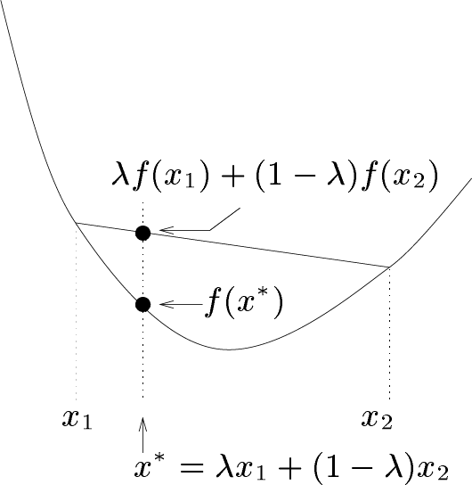
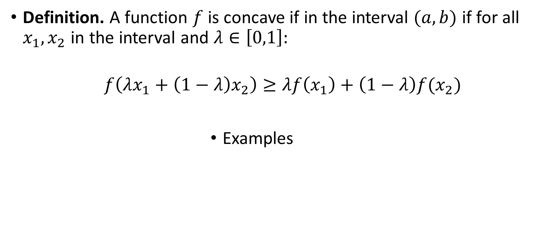
Concave functions
Definition. A function $f$ is concave if in the interval $(a,b)$ if for all $x_{1},x_{2}$ in the interval and $λ∈\left[0,1\right]:$
$$f\left(λx_{1}+\left(1−λ\right)x_{2}\right)≥λf\left(x_{1}\right)+\left(1−λ\right)f(x_{2})$$
Examples

Slide 3
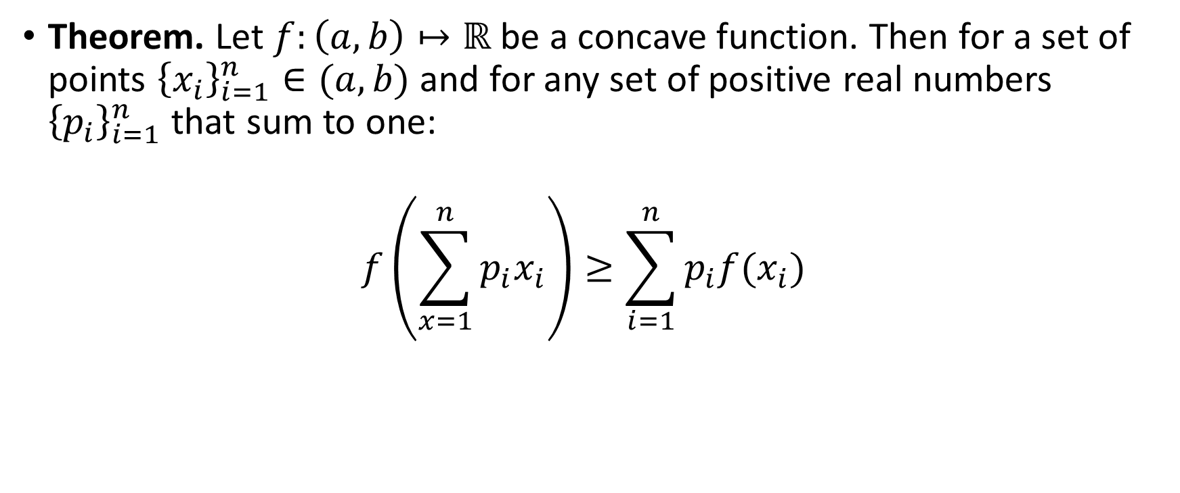
Jensen’s inequality
Theorem. Let $f:\left(a,b\right)↦ℝ$ be a concave function. Then for a set of points ${\left\{x_{i}\right\}}_{i=1}^{n}∈(a,b)$ and for any set of positive real numbers ${\left\{p_{i}\right\}}_{i=1}^{n}$ that sum to one:
$$f\left(\sum_{x=1}^{n}{p_{i}x_{i}}\right)≥\sum_{i=1}^{n}{p_{i}f(x_{i})}���p$$

Slide 4
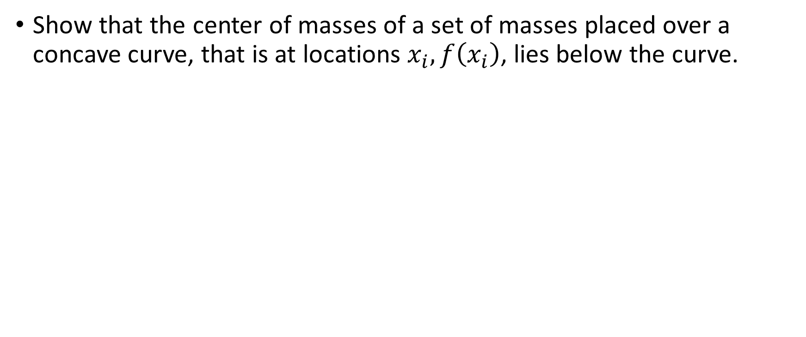

Exercise
Show that the center of masses of a set of masses placed over a concave curve, that is at locations $x_{i},f\left(x_{i}\right)$, lies below the curve.

Slide 5
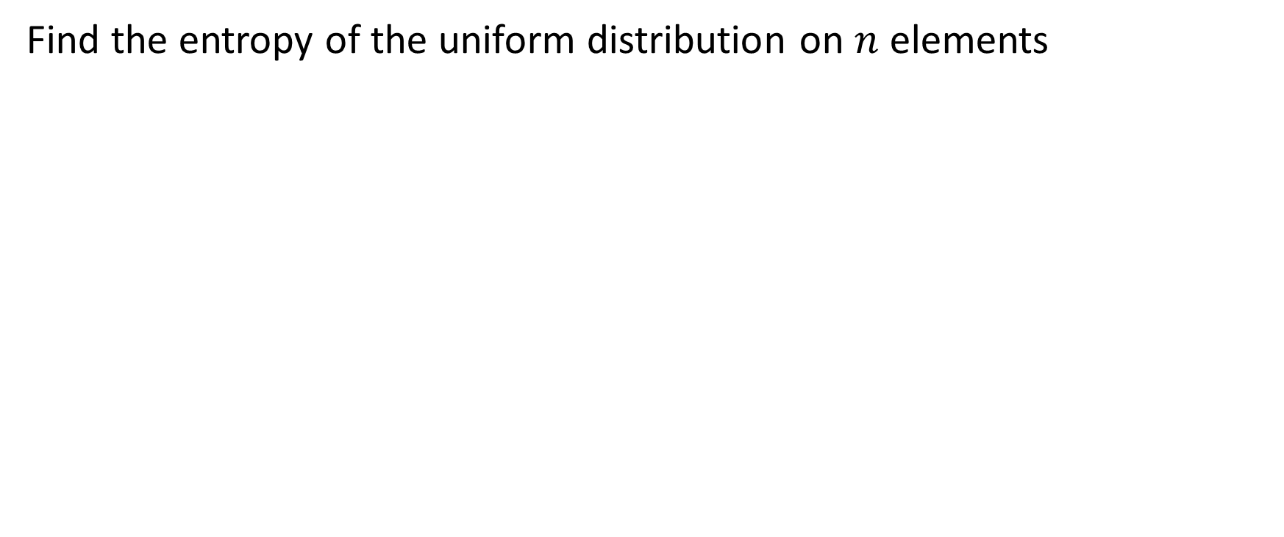
Exercise
Find the entropy of the uniform distribution on $n$ elements

Slide 6
Exercise
Show that the distribution that maximizes entropy for any alphabet size is the uniform distribution. (Hint: use Jensen’s inequality and the concavity of the log function).

Slide 7
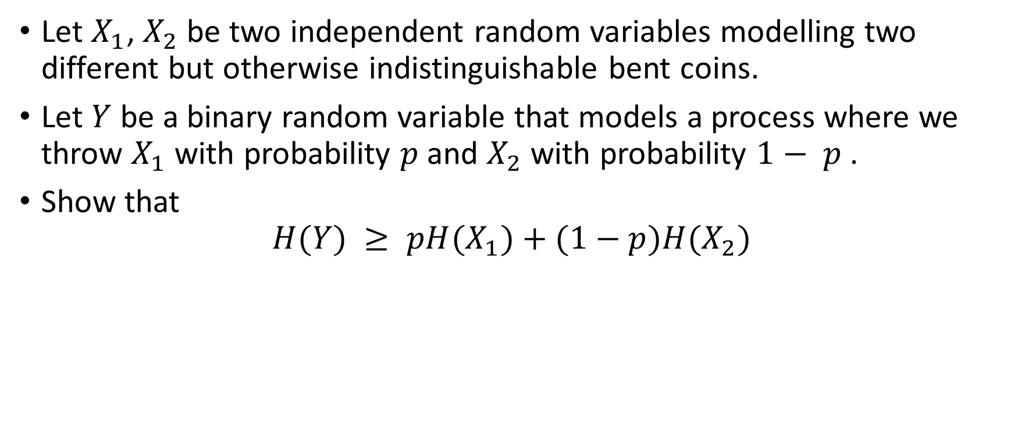
Exercise
Let $X_{1}$, $X_{2}$ be two independent random variables modelling two different but otherwise indistinguishable bent coins.
Let $Y$ be a binary random variable that models a process where we throw $X_{1}$ with probability $p$ and $X_{2}$ with probability $1− p$ .
Show that
$$H(Y) ≥ pH(X_{1})+(1−p)H(X_{2})$$

